Slide 1
GRUNDTVIG Partnerships Lets Go Cooking in Europe ‘LEGOCIE’ 2012-2014 Project Eating &Cooking Habbits Questionnaire Results and Conclusions (January-March 2013) Provincial Education Directorate of Gumushane /Turkey
40 people from our organisation participated in our survey and their average age is 40,2
They are all Turkish Citizens and government officials.(Working Hours 8:30-17:30)

Slide 4
In a typical week how often do you eat…?

Slide 5
Your Cooking Skillls

Slide 7
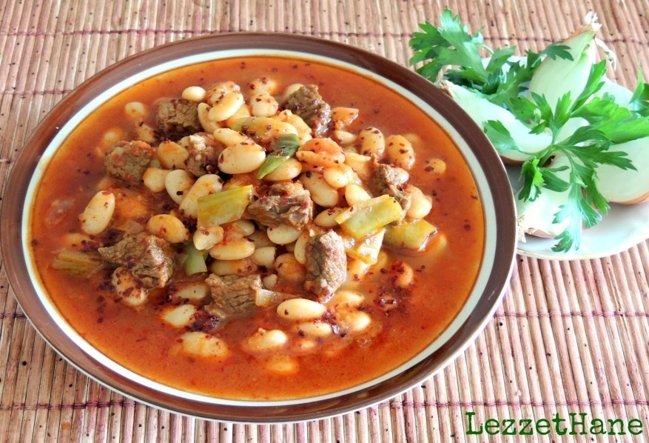
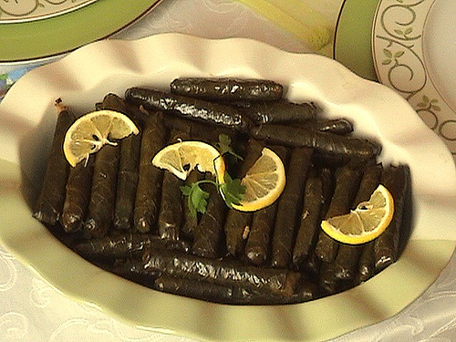
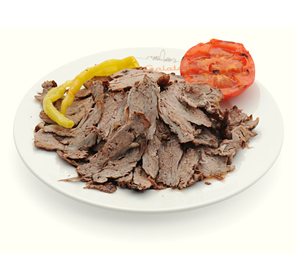
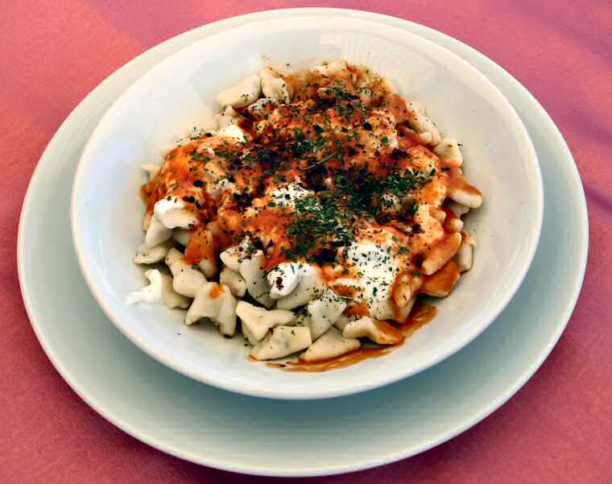
..and our favourite national/local dishes…
White bean stewed with meat
Staffed grape leaves with olive oil
Döner kebap
Turkish type ravioli (mantı)

Slide 8
Turkish diet habits summary in correspondence with the LEGOCIE survey:
The Turkish cuisine is millenarian, as well as the Turkish alimentary habits. Our recepies passes from grandmother-mother-daughter since generations and they are very traditional in their diet habits. We do not like much to try different kinds of food.
Beginning with a very oriental breakfast.... bread, olives, tomatoes, cucumbers, white cheese, honey,egg and black turkish tea. At the weekend some families can add to the table: an omelet or borek (pie filled with vegetables, meat or cheese), sucuk or pastirma (Turkish salamis), butter or fresh cream, marmelades, etc...
The lunch is served between 12:00 and 13:00 in the normal work days . In big cities people usually do not go back home for lunch. There are usually restaurants in big companies. Meals are generally simple but mainly from Turkish cousine. At street restaurants you can see typical dishes that can be chosen at self-service restaurants without having to wait a long time to be served.

Slide 9
We eat lots of bread with soup and all other dishes.
The Turkish hot dishes (main dishes) usually have some meat in it and a lot of vegetables, however the Southeast population eats more meat and in wetsern regions more vegetables
In all Turkish meals you will find bread: in breakfast, lunch or dinner. Yogurt is also commonly used as a cream over certain dishes.
Dinner is usually made at home with the family. The housewives love to cook and they make it very well. Due to rush of the daily life, women who work prepares easy turkish dishes. The dinner menu may be a repetition of what was eaten at lunch or for some families only a snack.
During the weekends Turks sometimes, or at least for one meal ,eat in restaurants or visit some friends.Usually when they visit friends they would find a banquet, the housewife works hardly to satisfy her guests.

Slide 10
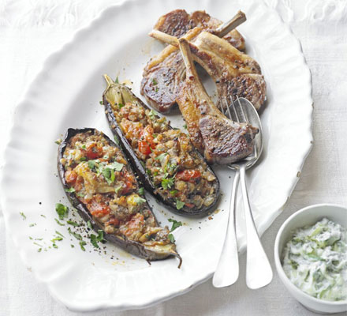
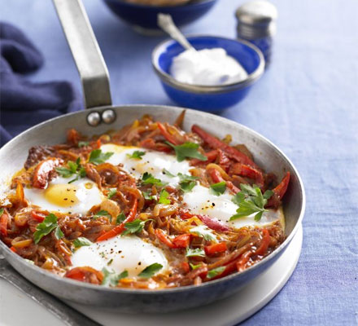
3 HEALTHY NATIONAL DISHES FROM TURKEY
Imam bayildi with lamb & tzatziki
Heat oven to 190C/170C. Halve the aubergines lengthways and score the flesh side deeply, brush with a good layer of olive oil and put on a baking sheet. Roast for 20 mins or until the flesh is soft enough to scoop out.
Fry the onion in a little oil until soft, add the garlic and cinnamon and fry for 1 min. Once the aubergines are cool enough to handle, scoop out the centres. Roughly chop the flesh and add it to the onions. Halve the tomatoes, scoop the seeds and juice into a sieve set over a bowl, then chop the flesh. Add the chopped tomatoes to the pan and cook everything for 10 mins until nice and soft. Add a little more oil if you need to. Stir in the parsley, leaving a little for scattering at the end.
Lay the aubergine halves in a baking dish and divide the tomato mixture between them. Pour over the juice from the tomatoes, drizzle with more olive oil and bake for 30 mins until the aubergines have collapsed.
Meanwhile, mix the tzatziki ingredients together and put in a small serving bowl.
Season the lamb with salt, black pepper and a pinch of paprika. Griddle, grill or barbecue for 3 mins on each side or until the fat is nicely browned, then put in a serving dish and squeeze over the lemon halves. Scatter the aubergines with parsley, then serve with the lamb and tzatziki.
Per serving
435 kcalories, protein 27g, carbohydrate 12g, fat 32 g, saturated fat 14g, fibre 5g, sugar 10g, salt 0.27 g
Turkish one-pan eggs & peppers (Menemen)
Heat the oil in a heavy-based frying pan. Stir in the onions, pepper and chillies. Cook until they begin to soften. Add the tomatoes and sugar, mixing well. Cook until the liquid has reduced, season.
Using a wooden spoon, create 4 pockets in the tomato mixture and crack the eggs into them. Cover the pan and cook the eggs over a low heat until just set.
Beat the yogurt with the garlic and season. Sprinkle the menemen with parsley and serve from the frying pan with a dollop of the garlic-flavoured yogurt.
222 kcalories, protein 12g, carbohydrate 12g, fat 15 g, saturated fat 4g, fibre 3g, sugar 9g, salt 0.39

Slide 11
Turkish lamb pilau
Dry-fry the pine nuts or almonds in a large pan until lightly toasted, then tip onto a plate. Add the oil to the pan, then fry the onion and cinnamon together until starting to turn golden. Turn up the heat, stir in the lamb, fry until the meat changes colour, then tip in the rice and cook for 1 min, stirring all the time.
Pour in 500ml boiling water, crumble in the stock cube, add the apricots, then season to taste. Turn the heat down, cover and simmer for 12 mins until the rice is tender and the stock has been absorbed. Toss in the pine nuts and mint and serve.
MAKING IT LIGHTER Use chicken with chicken stock instead of lamb and currants instead of apricots. IF YOU WANT TO USE A SLOW COOKER... Take your time over this. Toast the nuts according to step 1 and set aside. Fry the onion, cinnamon and spices together for 5-10 mins. Turn up the heat and add the lamb and fry until it changes colour. Tip into the slow cooker with the rice and stir. Pour in the water, crumble the stock cube, add the apricots and season. Cook on Low for 3-4 hours until the rice is tender. Toss in the nuts and mint to serve.
Per serving
584 kcalories, protein 32g, carbohydrate 65g, fat 24 g, saturated fat 9g, fibre 3g, salt 1.4 g

Slide 12
Conclusion
In these days, people have more health problems that are related with the new eating habits and fast food consumption. Despite some advantages of fast food the harm caused by fast food does not outweigh its benefit. We think that people should consider the negative fact of fast food consumption and the benefits of preparing their own food at home. It`s unfair that the traditional food which arrive to us from generation to generation we are going to replace it with junk food that will harm us more than benefit us. It`s unfortunate to lose the cooking tradition and eating homemade food prepared by our mothers together around the table. We are sure that all of us must think over this problem and try to find the appropriate solution to save our cultures, our traditional foods, and more importantly our health. So we should take action immediately to preserve traditional food and encourage people to prepare their own dishes, so they can stay healthy and live longer. Even though fast food is cheap, convenient, yummy and available in every corner in our cities, but that does not mean that our health is cheaper than the fast food that we eat.

Slide 13
Finally here is our suggestions and bindings to promote cooking and healthy eating not only in our county but also all over the world.
Increasing interst for national/international gourmet blogs,web sites for healthy eating like Punchfork.com,chefspack,com ,saglıklıyemektarifleri.com..,herkessofraya.com etc.
Promoting restaurants selling homemade food.
National, International Food festivals,Chefs Competitions
Tv programs masters of chef,We are in the Kitchen ,what should i cook today etc
When we find a chance, doing shopping with kids to prepare a healthy diner to get them adopt the habit of eating at home .
Thank you for your attention and wish you all healty days…

